Slide 1


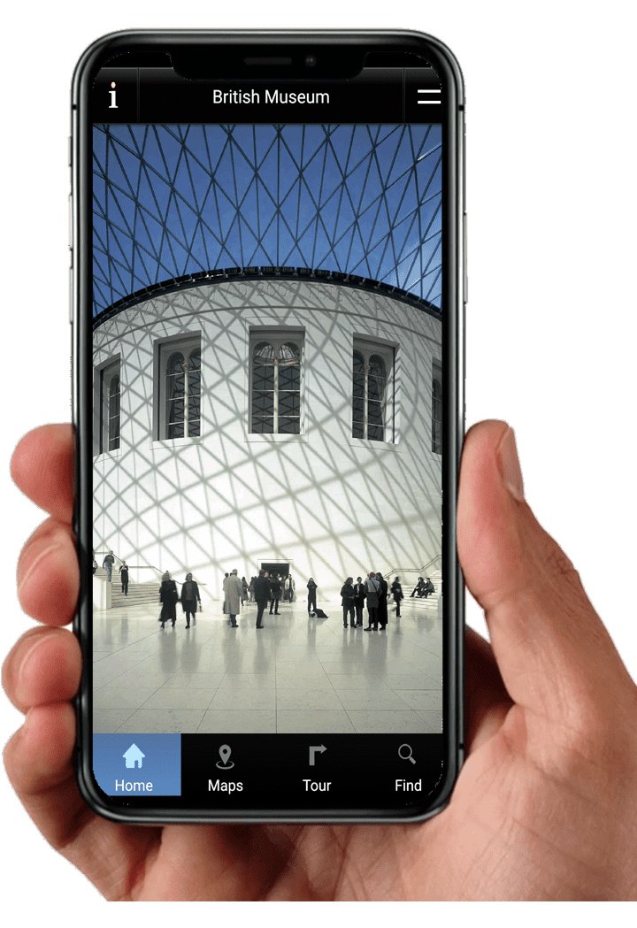
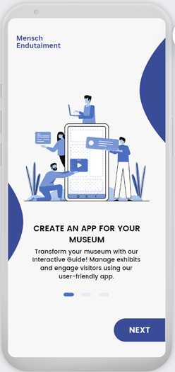
Interactive Museum Guide and Content Creation System for Mensch Edutainment
Supervisor: Dr. Julia Sheidin
Shay Garbuz and May Caspi

Slide 2
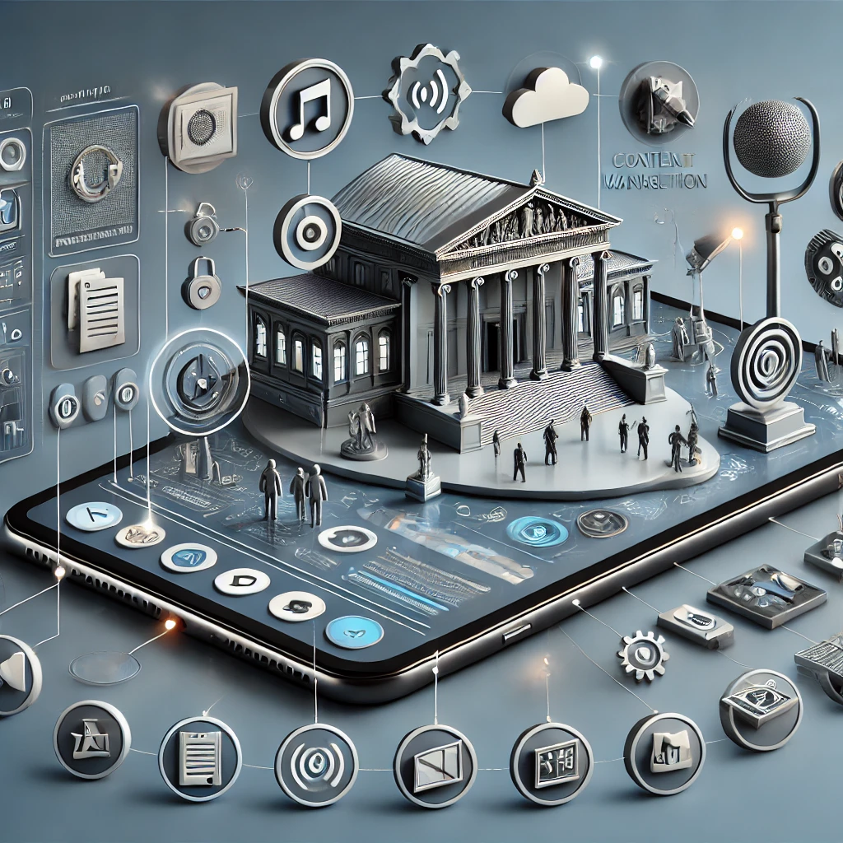
Background
In the digital age, museums are increasingly turning to technology to enhance visitor experiences. However, current solutions often lack the flexibility needed by museum staff and require significant technical expertise. There is a growing need for a more adaptable and user-friendly content management system that can meet the evolving demands of museums and their audiences.
Notes:
In today's digital age, museums are embracing technology to create more engaging and interactive experiences for their visitors. Despite this shift, many of the current technological solutions available are rigid and require extensive technical knowledge to operate. This creates a gap between the potential of technology and its practical application in museums. There's a pressing need for a more flexible and user-friendly content management system that empowers museum staff to easily adapt and tailor their digital offerings to meet the changing needs of their visitors and the museum's evolving objectives.

Slide 3
Introduction
The "Interactive Museum Guide and Content Creation System" developed in collaboration with the Mensch-Edutainment Company, is designed primarily for museum and galleries owners, providing them with a comprehensive and intuitive platform to create, manage, and update exhibit content.
The output of this system is a dynamic mobile application for visitors, enhancing their museum experience through engaging and interactive content
Notes:
We present to you the 'Interactive Museum Guide and Content Creation System', a project developed in collaboration with the Mensch-Edutainment Company. This system is specifically designed to cater to the needs of museum and gallery owners, offering them a robust and intuitive platform to effortlessly create, manage, and update exhibit content.
The result? A dynamic mobile application tailored for museum visitors, significantly enhancing their experience with engaging, interactive content. This system not only enriches the visitor journey but also empowers museum staff with the tools they need to keep content fresh and relevant."

Slide 4
Enable museums to independently create and manage exhibit content
Provide a cost-effective solution that minimizes the need for external developers.
Project Objectives
Enhance visitor engagement through an interactive mobile application.
Notes:
Our project aims to achieve three key objectives:
Empower Museums to Self-Manage Content: We want to enable museums to independently create and manage their exhibit content, giving them the control and flexibility to update and personalize their offerings without relying on external expertise.
Cost-Effective Solution: By minimizing the need for external developers, our system provides a cost-effective solution for museums. This allows them to allocate resources more efficiently while still achieving high-quality, engaging content.
Enhance Visitor Engagement: Our interactive mobile application is designed to enhance the visitor experience by making exhibits more engaging and immersive, transforming the way visitors interact with and learn from museum displays.

Slide 5
Our solution, the "Interactive Museum Guide and Content Creation System," provides a comprehensive and flexible platform that allows museums to manage exhibit content efficiently. Key features include real-time updates, seamless multimedia integration, and mobile accessibility, all designed to enhance both the museum staff's workflow and the visitor's experience.
Notes:
Our solution, the 'Interactive Museum Guide and Content Creation System,' is a comprehensive and flexible platform designed to revolutionize how museums manage their exhibit content. Key features of our system include:
Real-Time Updates: Museums can make instant changes to exhibit content, ensuring that information remains current and relevant.
Seamless Multimedia Integration: Our platform supports the easy integration of various media types, such as images, videos, and audio, creating a richer and more immersive experience for visitors.
Mobile Accessibility: The system is designed with mobile users in mind, providing visitors with easy access to interactive content through their smartphones.
These features are aimed at enhancing the workflow of museum staff while simultaneously enriching the overall visitor experience, making exhibits more engaging, informative, and interactive.

Slide 6
Content Creation and Management (CMS)
A Content Management System (CMS) is a software application designed to facilitate the creation, editing, and publishing of content by multiple users.
The key components are:
Content Creation Tools - for editing and designing.
Content Management - for content managing.
Notes:
Our system features a robust Content Management System (CMS), a software application specifically designed to make it easy for multiple users to create, edit, and publish content.
The CMS is built around two key components:
Content Creation Tools: These tools provide museum staff with intuitive interfaces for editing and designing exhibit content. This includes text, images, videos, and interactive elements that can be easily tailored to suit different exhibits.
Content Management: This component handles the organization, storage, and retrieval of content. It allows staff to efficiently manage content across different exhibits, ensuring consistency and ease of access.
Together, these components enable museum staff to maintain a dynamic and engaging digital presence, keeping exhibit information up-to-date and relevant.

Slide 7





Technology Stack
The system is built using modern, scalable technologies:
Frontend
Backend
Database
Mobile App
React.js
Node.js with Express.js
MongoDB and Firebase
Cross-platform compatibility
Notes:
Technology Stack
Our system is built using a selection of modern, scalable technologies, ensuring reliability, efficiency, and adaptability:
Frontend: We use React.js for the frontend, offering a dynamic and responsive user interface. React's component-based architecture allows us to build reusable UI components, which streamlines development and ensures a consistent user experience.
Backend: The backend is powered by Node.js with Express.js, providing a robust and scalable server environment. Node.js allows for efficient handling of asynchronous operations, which is crucial for a responsive and high-performance system.
Database: For data management, we utilize both MongoDB and Firebase. MongoDB offers a flexible, schema-less data structure that is ideal for handling the diverse and evolving data types found in museum content. Firebase complements this by providing real-time data synchronization, which is essential for real-time updates in the CMS and the mobile app.
Mobile App: Our mobile application is designed with cross-platform compatibility in mind, ensuring that it can be accessed on both Android and iOS devices. This approach maximizes our reach and makes the interactive museum experience accessible to a broader audience.
By leveraging these technologies, our system provides a seamless and integrated experience for both museum staff and visitors.

Slide 8
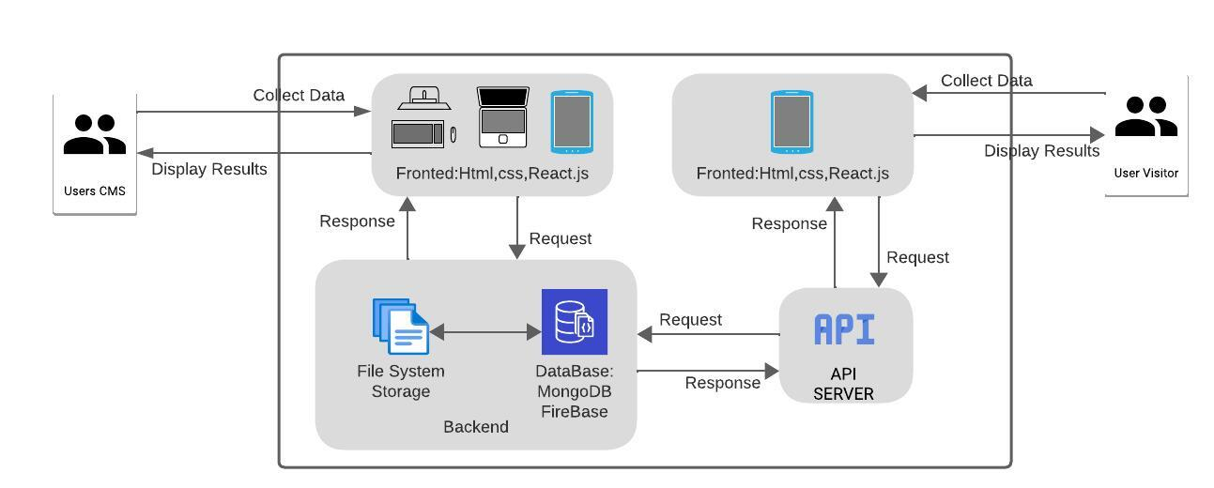
System’s Architecture
The system's architecture is designed to ensure scalability, reliability, and ease of use for both museum staff and visitors. It comprises several key components:
Notes:
System's Architecture
Our system's architecture is carefully designed to ensure scalability, reliability, and ease of use, benefiting both museum staff and visitors. The architecture includes several key components:
Frontend Layer: Built with HTML, CSS, and React.js, the frontend is where users interact with the system. For museum staff, the CMS interface allows easy content creation and management. For visitors, the mobile application provides a seamless and engaging experience.
Backend Layer: The backend is the backbone of our system, handling requests and managing data. It consists of:
File System Storage: This handles the storage of multimedia files, ensuring that images, videos, and other content types are readily accessible.
Database: We utilize MongoDB and Firebase for data storage and real-time data synchronization. These databases store all exhibit information, user interactions, and other relevant data.
API Server: The API server acts as an intermediary between the frontend and backend, handling requests, processing data, and returning the appropriate responses. It ensures that data flows smoothly and efficiently, whether it's content being updated by museum staff or information being requested by a visitor's mobile app.
By integrating these components, our architecture provides a robust and scalable solution that meets the needs of modern museums, ensuring that content is always up-to-date and accessible, enhancing both the staff's efficiency and the visitor's experience.

Slide 9





Admin
Manages system operations, subscriptions, and access control.
Museum Owner
User Roles
Oversees exhibits, assigns curators, and customizes content
The system supports multiple user roles, each with specific permissions:
Curator
Creates and updates exhibit content, including multimedia elements
Visitor
Interacts with museum content through the mobile app
Notes:
User roles:
Our system is designed to support multiple user roles, each with specific permissions to ensure a secure and efficient workflow. The key user roles are:
Admin: Responsible for managing overall system operations, including user subscriptions and access control. Admins ensure the system runs smoothly and securely.
Museum Owner: Museum owners oversee all aspects of the museum's digital presence. They are responsible for managing exhibits, assigning curators, and customizing content to align with the museum's vision and goals.
Curator: Curators play a crucial role in creating and updating exhibit content. They have the ability to add and manage multimedia elements, ensuring that the content is engaging and informative.
Visitor: Visitors interact with the museum's content through our mobile application. They explore exhibits, access multimedia content, and enjoy a personalized and interactive museum experience.
By defining these roles and permissions, our system ensures that each user has access to the tools and information they need, enhancing both operational efficiency and the visitor experience.

Slide 10



FUNCTIONAL REQUIREMENTS
The ability to create, edit, and delete exhibit content with ease.
Upload multimedia elements such as audio, video, and images directly from mobile devices.
Assign exhibits to specific tours and provide real-time updates to the visitor app
Notes:
Slide 9: Functional Requirements
Our system is designed with specific functional requirements to ensure it meets the needs of both museum staff and visitors effectively. The key functional requirements include:
Content Management: Users must have the ability to create, edit, and delete exhibit content easily. This empowers museum staff to keep exhibits up-to-date and relevant without needing extensive technical knowledge.
Multimedia Uploads: The system supports uploading multimedia elements such as audio, video, and images directly from mobile devices. This feature allows for richer, more engaging content that enhances the visitor experience.
Tour Management and Real-Time Updates: The ability to assign exhibits to specific tours and provide real-time updates to the visitor app ensures that visitors receive the most accurate and relevant information as they explore the museum.
These functional requirements are central to our goal of creating a user-friendly, dynamic, and interactive system that enhances both content management for staff and the overall experience for visitors.

Slide 11
NON-FUNCTIONAL REQUIREMENTS
The system must handle an increasing number of users and content without performance degradation.
The interface must be intuitive, requiring minimal training.
Support for multiple languages and assistive technologies is essential to accommodate diverse user needs.
Notes:
Non-Functional Requirements
"In addition to the functional capabilities, our system must also meet several non-functional requirements to ensure it is reliable, user-friendly, and accessible. These include:
Scalability: The system must be capable of handling an increasing number of users and a growing volume of content without any performance degradation. This ensures that as the museum's digital content expands, the system remains responsive and efficient.
Usability: The interface must be intuitive and require minimal training. By focusing on ease of use, we ensure that museum staff can quickly adopt the system and use it effectively, regardless of their technical background.
Accessibility: Support for multiple languages and assistive technologies is essential. This requirement ensures that the system accommodates diverse user needs, making the museum experience accessible to a broader audience, including those with disabilities or language barriers.
By meeting these non-functional requirements, our system ensures a high-quality, inclusive, and scalable experience for all users.

Slide 12
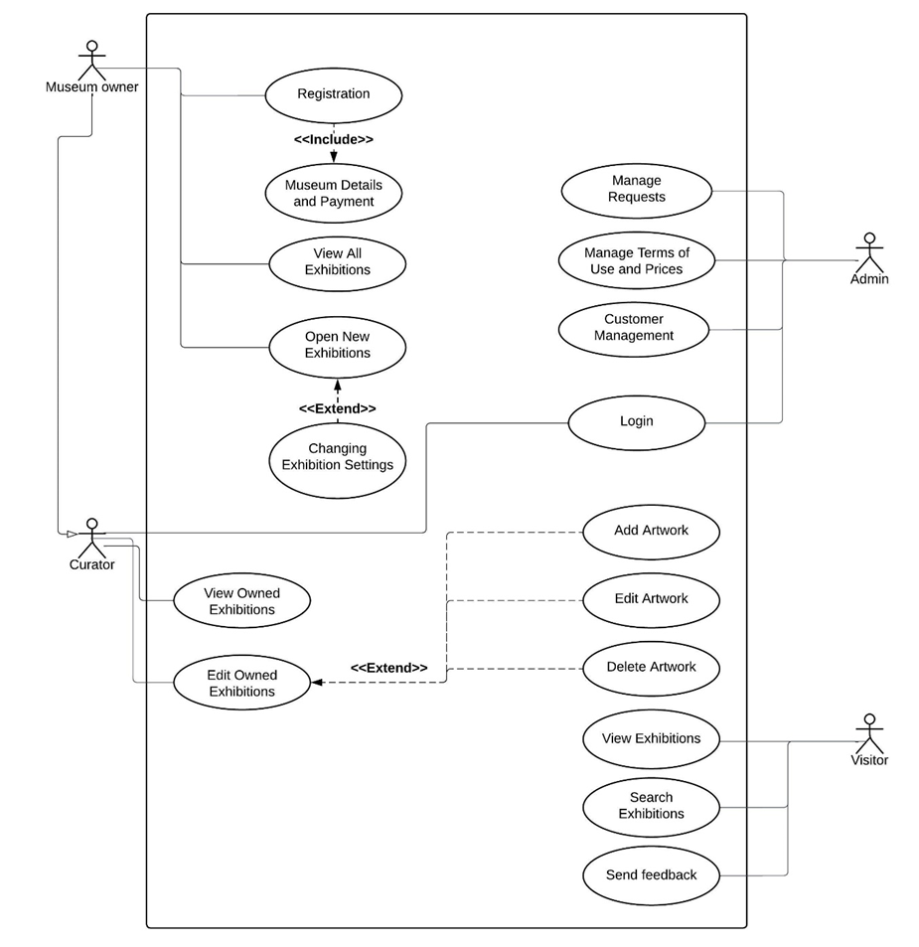

Use-Case Diagram
Notes:
This use-case diagram provides an overview of the interactions between different user roles and the system. It illustrates the various actions that can be performed by each role:
Museum Owner: This role includes actions such as registration, managing museum details and payments, viewing all exhibits, creating new exhibits, and changing exhibit settings. These capabilities allow museum owners to have comprehensive control over their museum's digital content.
Curator: Curators are primarily focused on content creation and management. They can view owned exhibits, edit exhibit details, and manage individual artwork, including adding, editing, and deleting artwork. This role ensures that exhibit content is up-to-date and engaging.
Admin: The admin role includes managing system operations such as handling requests, managing terms of use and pricing, and customer management. This role ensures the smooth operation of the system and compliance with policies.
Visitor: Visitors interact with the system primarily through viewing exhibits and searching for specific exhibitions. They can also send feedback, contributing to the museum's ongoing improvement.
This diagram effectively highlights the specific functionalities available to each user role, ensuring that each type of user can perform their required tasks efficiently and effectively."

Slide 13
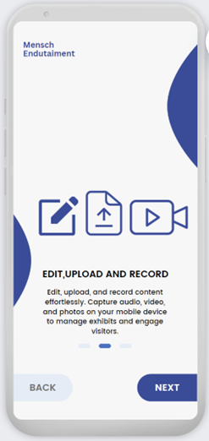
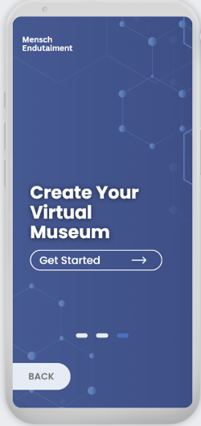
Museum Owner view
The initial screen that a museum owner encounters upon opening the app. This page provides a welcome message and the option to register as a new user.

Slide 14
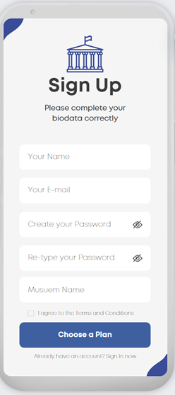
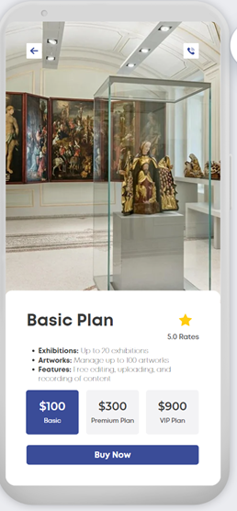
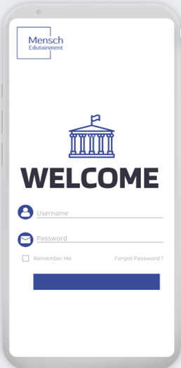
Museum Owner view
The registration page where new users can create an account by entering their personal details such as name, email, and password. This ensures secure access to the app's features (like choosing a plan and more).

Slide 15
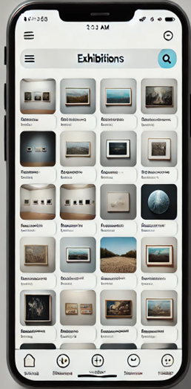
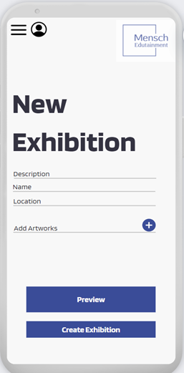
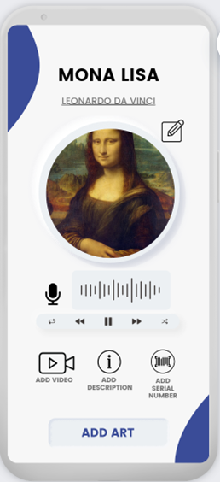
Curator view
The curator can navigate to a form for creating a new exhibition. He can enter details such as the exhibition title, description, and upload related artworks.

Slide 16
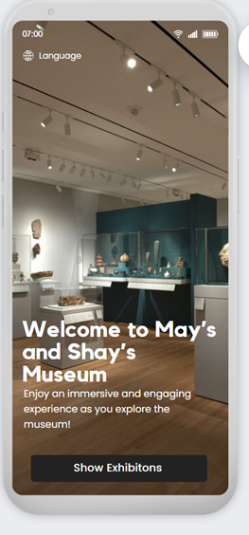
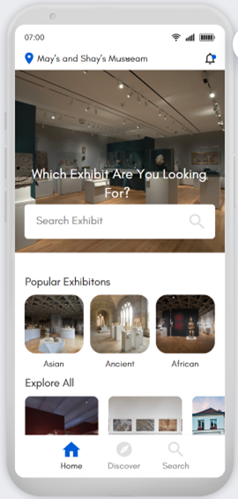
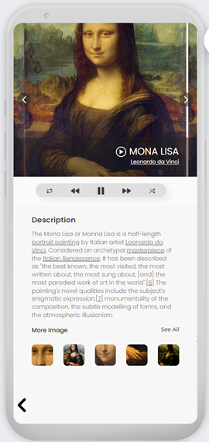
Visitor view
The visitor is led to the homepage for a specific museum, showcasing current exhibitions, upcoming events, and highlighted artifacts. Visitors can navigate to different sections to learn more about each exhibit

Slide 17
User Constraints
Ensuring the system was accessible and easy to use for all user types.
1
Constraints and Challenges
Technical Constraints Maintaining consistent performance across different devices and platforms.
2
3
Time Constraints
Managing the project timeline effectively to meet deadlines
Notes:
Throughout the development of our system, we encountered several constraints and challenges that we needed to address to ensure a successful outcome:
User Constraints: One of our primary challenges was ensuring that the system was accessible and easy to use for all types of users, including museum staff with varying levels of technical expertise and visitors with diverse needs. We focused on designing an intuitive interface that requires minimal training and is easy to navigate.
Technical Constraints: Another significant challenge was maintaining consistent performance across different devices and platforms. Given the need for mobile accessibility and cross-platform compatibility, we needed to ensure that our system could perform efficiently, regardless of the user's device or operating system.
Time Constraints: Managing the project timeline effectively to meet deadlines was crucial. With a defined project scope and deliverables, we had to carefully plan and allocate resources to ensure that we could deliver a fully functional system on time.
By addressing these constraints and challenges, we were able to develop a robust, user-friendly system that meets the needs of both museum staff and visitors.

Slide 18
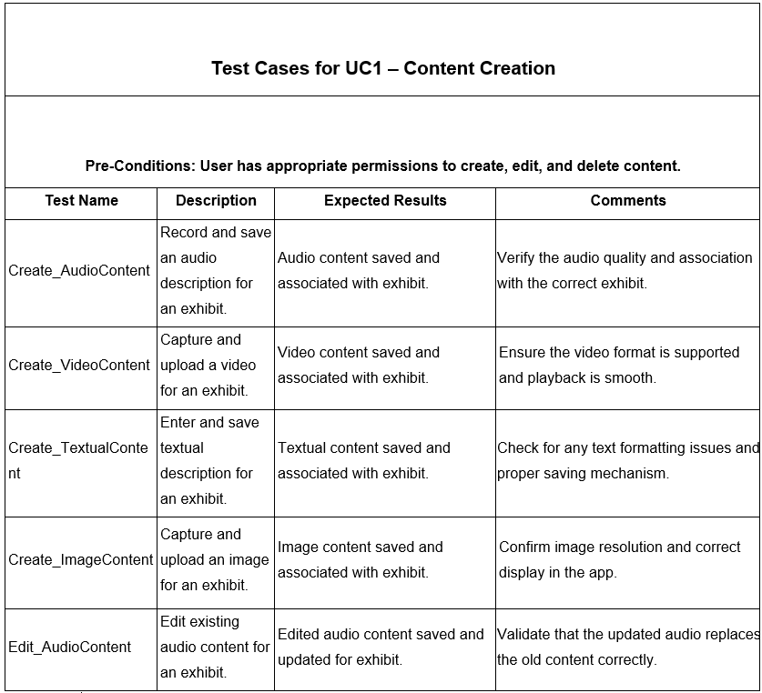
Evaluation
 | Evaluation of Menachem Menachem's role is crucial in ensuring that the system aligns with the needs and expectations of museum staff and visitors.
 | Test Plan The purpose of this test plan is to ensure that the system meets its requirements and performs as expected.
Notes:
Our evaluation process is critical to ensuring that the system meets the needs and expectations of both museum staff and visitors. This slide outlines our approach to evaluation, focusing on two key areas:
Evaluation of Menachem: Menachem's role is crucial in aligning the system with the specific requirements of museum environments. By actively engaging with museum staff and understanding their workflows, Menachem ensures that the system's functionalities are tailored to real-world needs. This ongoing evaluation helps in refining the system and making it more effective.
Test Plan: We have developed a comprehensive test plan to ensure that the system performs as expected. The purpose of this test plan is to validate that the system meets all functional requirements and handles various use cases effectively. For example, test cases cover different aspects of content creation, such as creating, editing, and deleting audio, video, and image content. Each test case is designed to verify that the system behaves correctly and consistently, providing reliable performance.
Through these evaluation methods, we continuously assess and enhance our system, ensuring it delivers a robust and user-friendly experience.

Slide 19
THANK YOU
THANK YOU
THANK YOU

